Slide 1

SLIDE 1
Team Name : Nisargah Builders
Leader Name : Rammya Dharshini K
Domain Name : Internet Of Things
Topic : IoT Home Application Using GSM - Cellular Based

Slide 2
SLIDE 2
ABSTRACT
Mobile phone is a revolutionary invention of the century. It was primarily designed for making and receiving calls & text messages, but it has become the whole world after the Smart phone comes into the picture.
We are building a home automation system, where one can control the home appliances, using the simple GSM based phone, just by sending SMS through his phone. In this project, no Smart phone is needed, just the old GSM phone will work to switch ON and OFF any home electronic appliances, from anywhere

Slide 3
SLIDE 3
NOVELTY
In most of the IoT-based home automation systems, the actuators and sensors are positioned within the home environment to control and supervise its operations.
Afterward, these devices are connected to the local server via a wireless medium for data collection and analysis.
One of the most important issues is how to securely transmit the collected data from the sensor nodes to the appropriate destination.

Slide 4
SLIDE 4
TECHNOLOGY STACK
Physical Device
Microcontroller - Arduino
Esp8266 - Wifi Module
Sensors
Relays
Software
Arudino Ide
TkinerCad - Software Simulation
Thinkspeak
MIT - App Inventor / Blynk

Slide 5
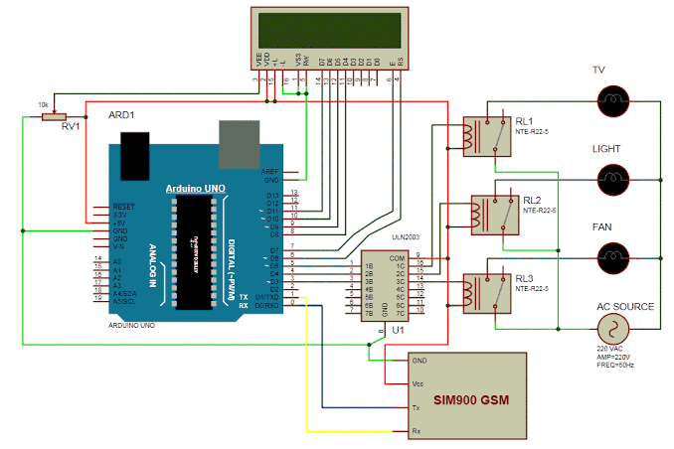
SLIDE 5
HARDWARE / SOFTWARE IMPLEMENTATION

Slide 6
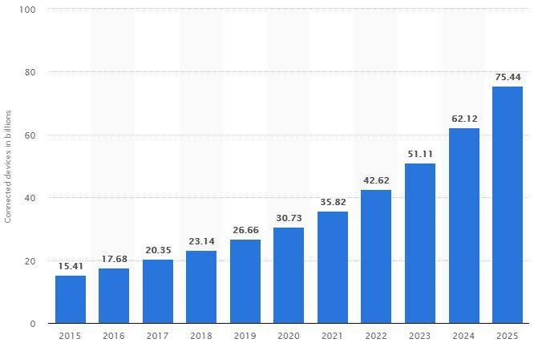
SLIDE 6
BUSINESS SCOPE
A smart city is no more a dream about self-driving inhabited unit with automated transport systems, governmental services, and housing services, but a challenge for IoT architects. In 2019, over 20% of all huge IoT projects were launched in this area. That means that these years there will be a strong demand for tech solutions connected with city life automation.

Slide 7
Thank you

